Slide 1
Reese Felts Digital Newsroom
John Clark
Executive Producer
johnclark@unc.edu
@johnclark
Sara Peach
Senior Producer
peach@email.unc.edu
@sarapeach

Slide 2
About the Project

Slide 3
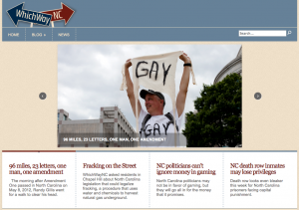
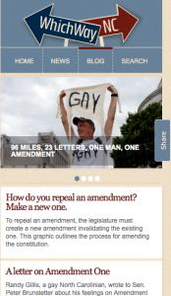
Responsive Design

Slide 4
Video for the Small Screen

Slide 5
The Roll Call

Slide 6
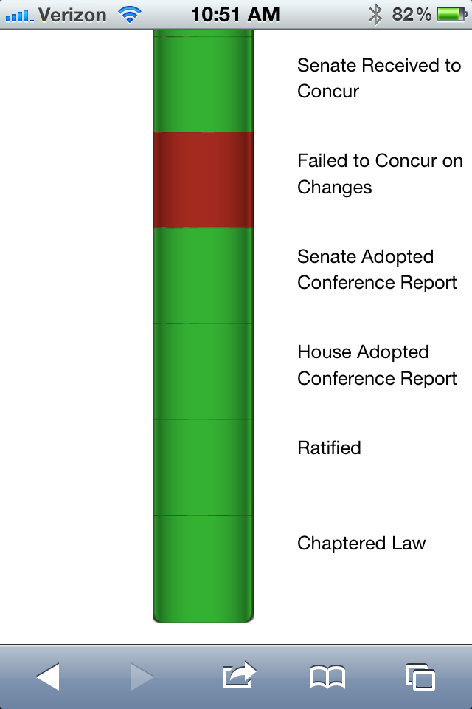
The Roll Call

Slide 7
Summary
Harder than you would think
Must make every pixel count
Horizontal vs. Vertical – must accommodate both
If it works on the phone, it works on the desktop

Slide 8
Summary
External Links should be mobile
Choose simple fonts
Test on multiple devices
Fingers not as precise as the mouse

