Slide 1
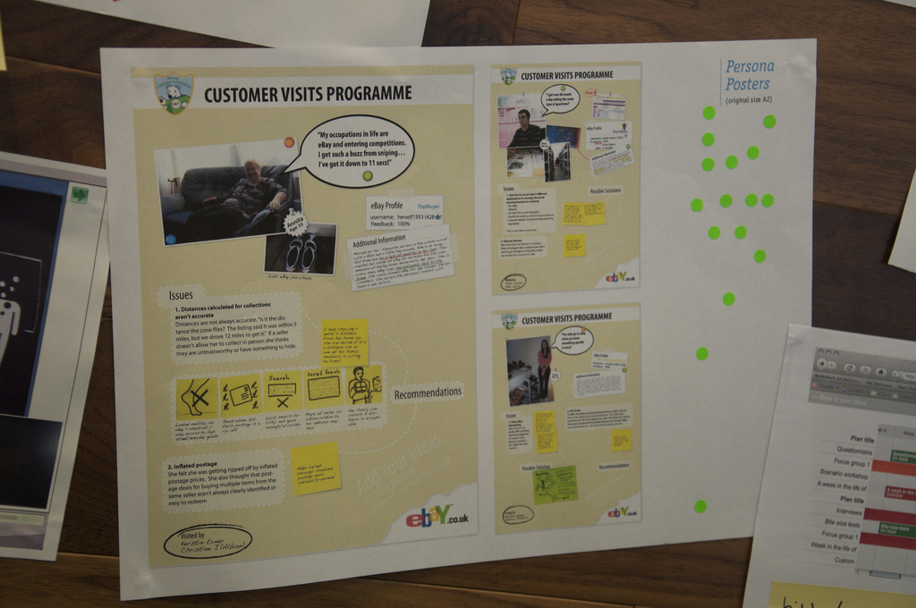
UX 101
Research + Strategy + Design
Abe Crystal, Ph.D. + Jackson Fox + Rick Cecil
morebetterlabs.com + ruzuku.com

Slide 2
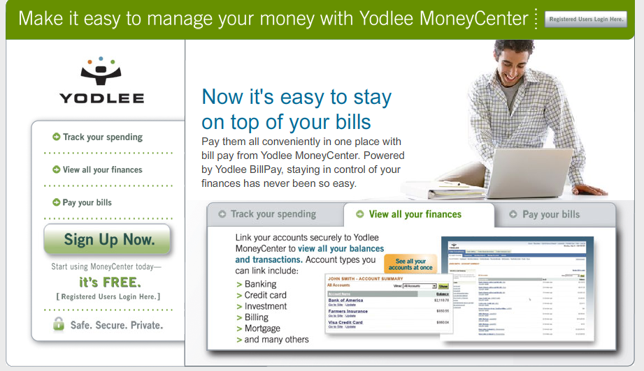

Slide 3
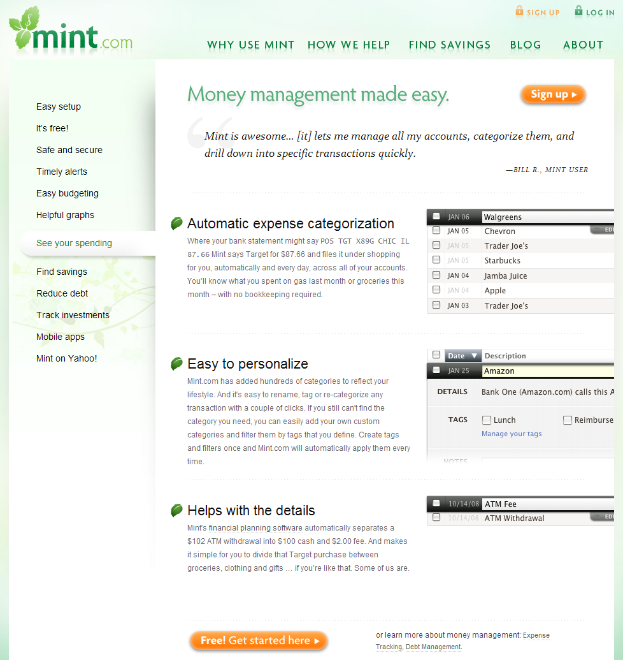

Slide 4




Agenda
Good UX vs. Bad UX
Creating great experiences
  Focus
  Empathy
  Clarity
Wrap-up and call to action

Slide 5

Good UX vs. Bad UX
Let’s get some concrete examples.
What products, tools, or services do you think provide a “good user experience?” Why?
How about “bad user experience?” Why?

Slide 6
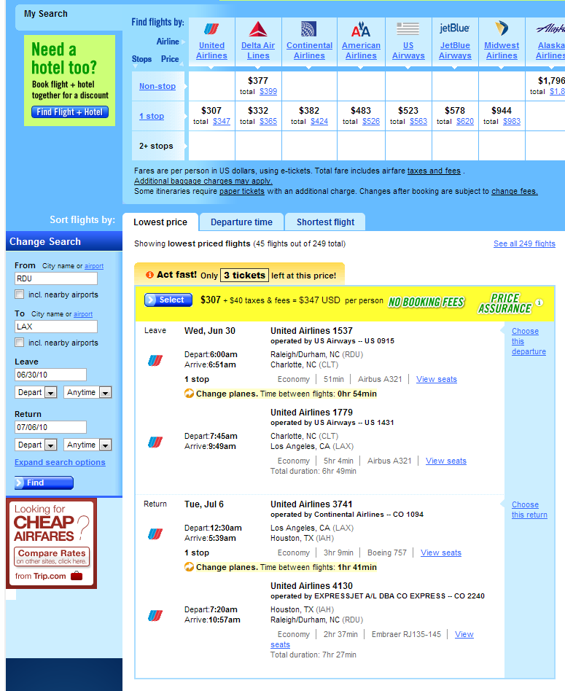

Slide 7
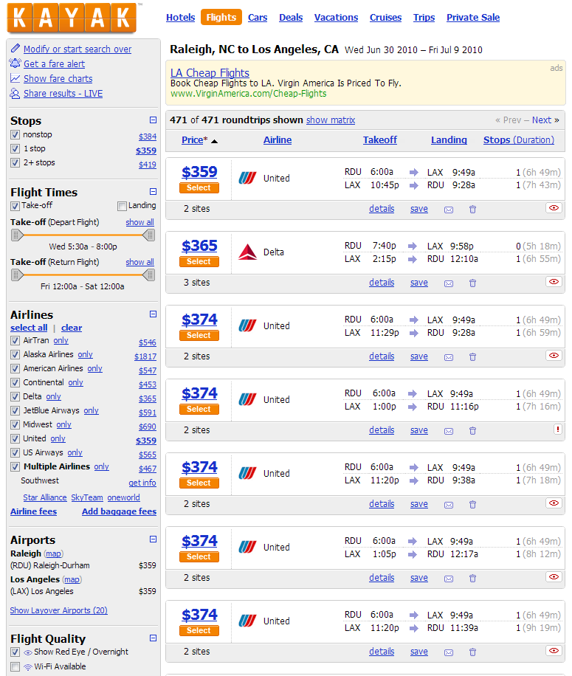

Slide 8
Good UX vs. Bad UX: Travel
Kayak | Orbitz
Clean layout, subtle colors, easy to scan | Complex, brightly colored, difficult to scan
Most important information (price, depart/arrive times) is obvious | Most important information is buried
Compare 12 flights on first screen (1600px) | Compare 2 flights on first screen (1600px)
Helps me eliminate undesirable flights (“Show Red Eye” checkbox) | Requires me to evaluate each flight (look for “This is an overnight flight” text)
Allows me to easily filter by price or airline | Can’t filter by price; choosing an airline reloads the page
Share search results live with a friend or family member | No way to share results; makes coordinating travel plans difficult

Slide 9
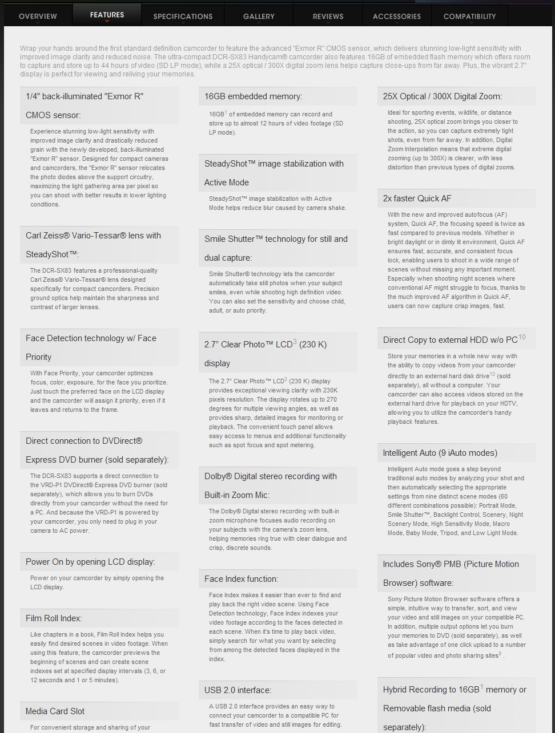
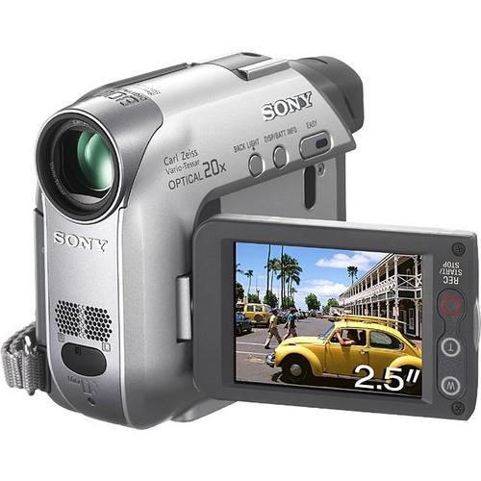
Good UX vs. Bad UX: Video

Slide 10
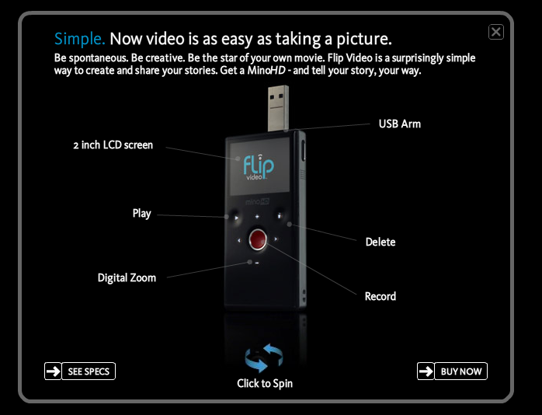
Good UX vs. Bad UX: Video

Slide 11
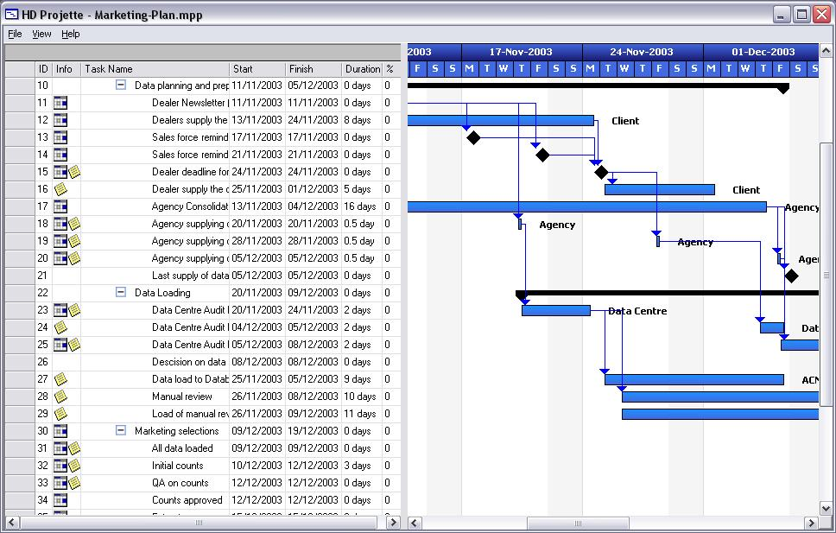
Good UX vs. Bad UX: Project Management

Slide 12
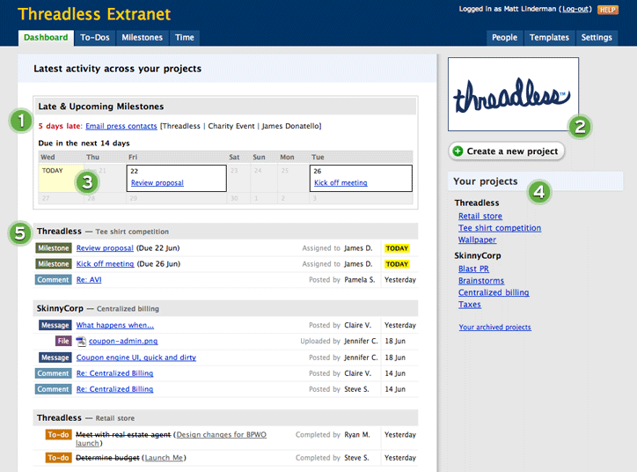
Good UX vs. Bad UX: Project Management

Slide 13




Follow their lead…

Slide 14
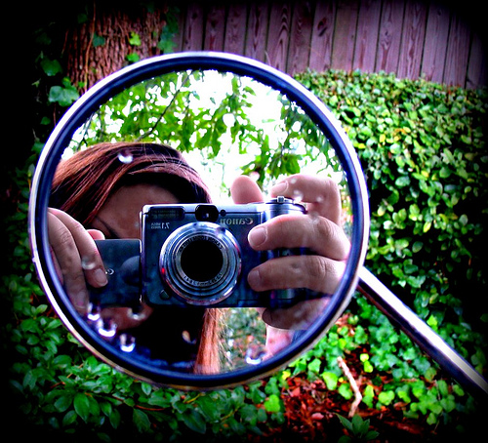
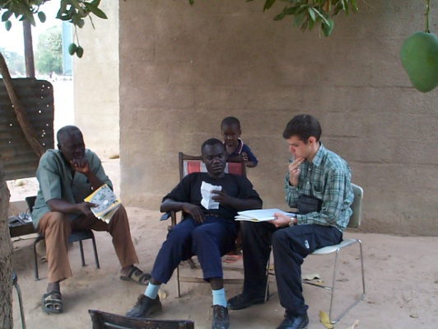

But how…?
Strategy is about FOCUS
Research is about EMPATHY
Design is about CLARITY

Slide 15
Strategy
Strategy is about FOCUS
Research is about EMPATHY
Design is about CLARITY

Slide 16
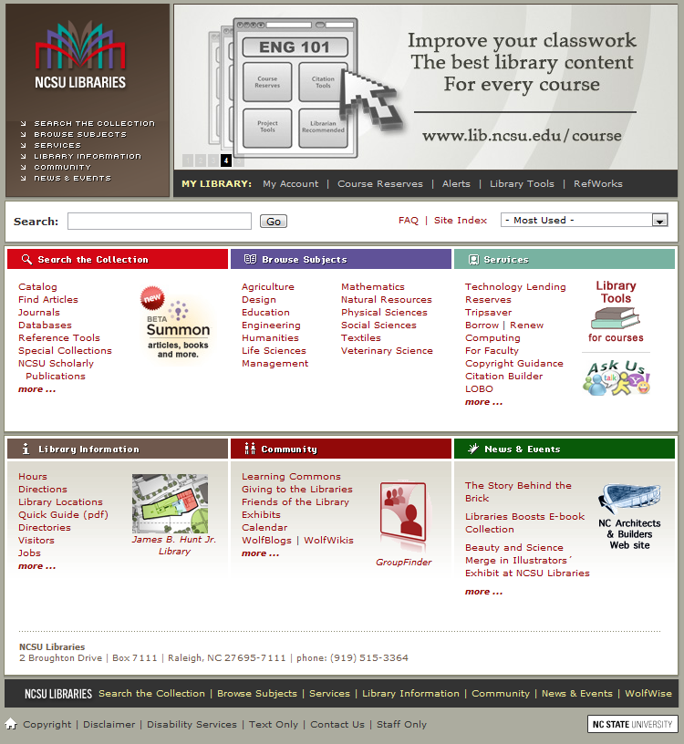
Case #1: NCSU Libraries Website
Many stakeholders, many users
How to work toward focus and addressing key user needs?

Slide 17
Case #1: NCSU Libraries Website
Many stakeholders, many users
How to work toward focus and addressing key user needs?

Slide 18
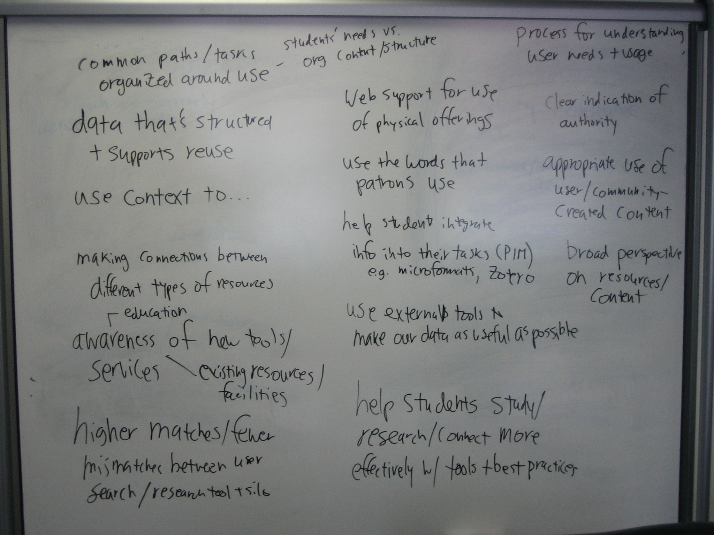

Slide 19
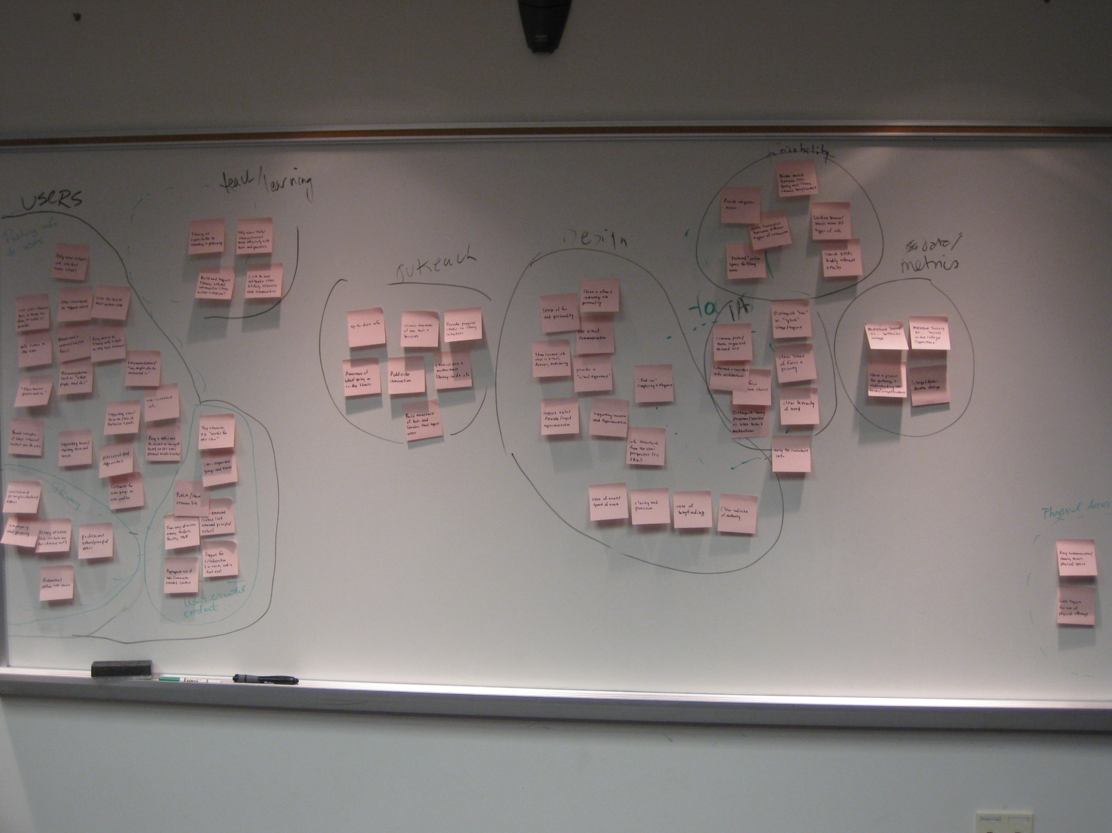

Slide 20
Reduce the data
21 pages (6,000+ words) of notes
4 key findings + 3 future directions

Slide 21
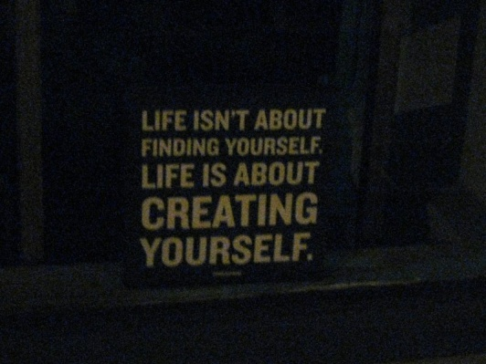

Focus, Jedi
Define a mantra and key “experience principles”
Create concrete and tangible (NOT abstract and high-falutin’) visions of a desirable future
Simplify, simplify – Say “no”

Slide 22
Mantras > Missions
“The mission of Wendy’s is to deliver superior quality products and services for our customers and communities through leadership, innovation, and partnerships.”
… or …
“Healthy fast food”

Slide 23
More Mantras
Federal Express: “Peace of mind”
Nike: “Authentic athletic performance”
Target: “Democratize design”
Mary Kay: “Enriching women’s lives”
Think about a mantra for your service, project, department…

Slide 24
Principles: concise, memorable guidelines
Google
  “Every millisecond counts.”
  “Add a human touch.”

Slide 25
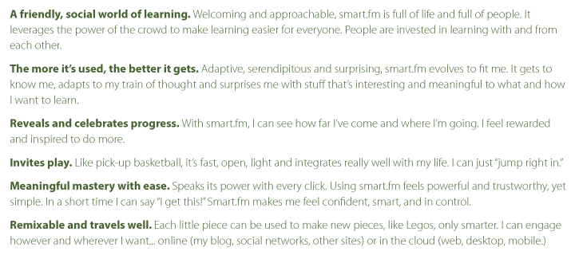
Principles: concise, memorable guidelines
slide credit: Adaptive Path

Slide 26
Make the future tangible
“If you want to build a ship, don't drum up people together to collect wood and don't assign them tasks and work, but rather teach them to long for the endless immensity of the sea.”
Antoine de Saint-Exupery

Slide 27

“Design the Box”

Slide 28
“Start with No”

Slide 29
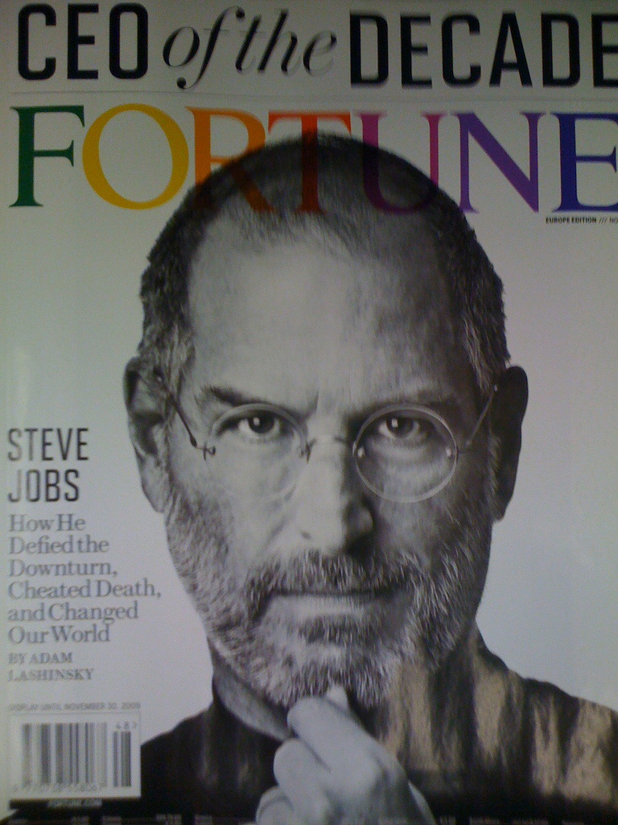
“Start with No”

Slide 30
Simplify, simplify
Apply it…
What feature or direction have you been considering (or developing), that you could say “no” to?

Slide 31
Research
Strategy is about FOCUS
Research is about EMPATHY
Design is about CLARITY

Slide 32

Case #2: Fuqua School of Business
Multiple user communities, little collaboration
Content and community fragmented over many sites and applications

Slide 33
Case #2: Fuqua School of Business
Identify and prioritize key user motivations, goals, needs, and tasks
Interviews,
Analysis,
Ideation

Slide 34
Theme: Communicating and Connecting
I really enjoyed the online discussions focused on the week’s reading in a class. [WEMBA student]
After class is completed, the discussion board goes away, and students miss this. [faculty]
We could save effort by using publicly available tools, rather than in-house software. [WEMBA student]
We set up our own Google Group, rather than use the class discussion board, because an alumnus wanted to participate in our discussions. [WEMBA student]
As an executive student, it’s been difficult to get involved in student clubs. [WEMBA student]
I had a few alumni email me out of the blue, but it never really generated a relationship. [WEMBA student]
I know so many people in the pharmaceutical industry, and could help others from HSM connect to them. [alumni/certificate student]
I’ve used the alumni database to find contacts, but it’s limiting in terms of how I can browse and search—I wanted to be able to connect with other MD/MBA’s. [WEMBA student]

Slide 35

Stories from the future of HSM...
Karen
EMBA alumna
director of marketing, clinical research company
As soon as I graduated, I started to miss the lively discussions I had with my classmates on the learning platform. And it's hard to keep up with people without the regular rhythms of class and assignments to connect us. It's great to see my classmates active on HSM, because I feel it we’re still part of the team, even though we live in different cities and don't get together as often. I hope we’ll stay connected through this platform for a long time.

Slide 36
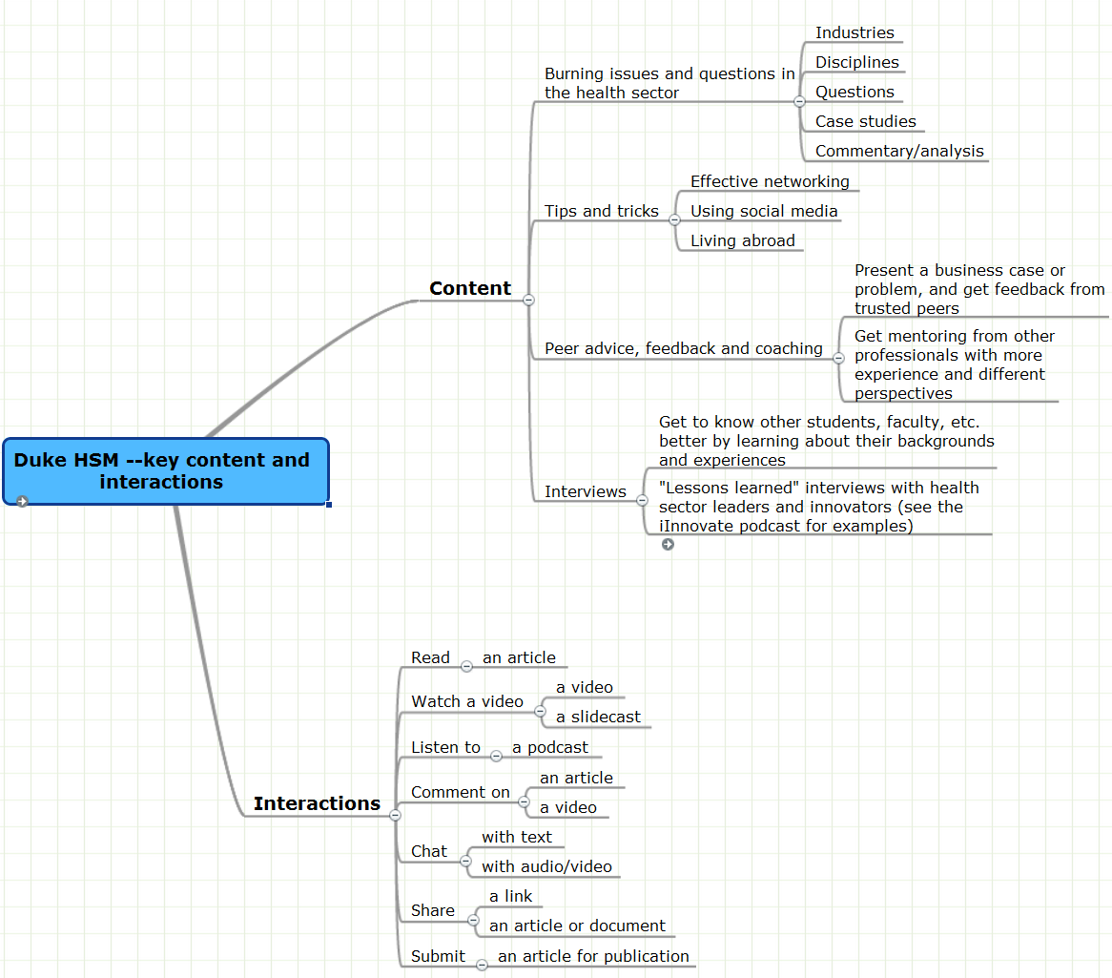

Slide 37
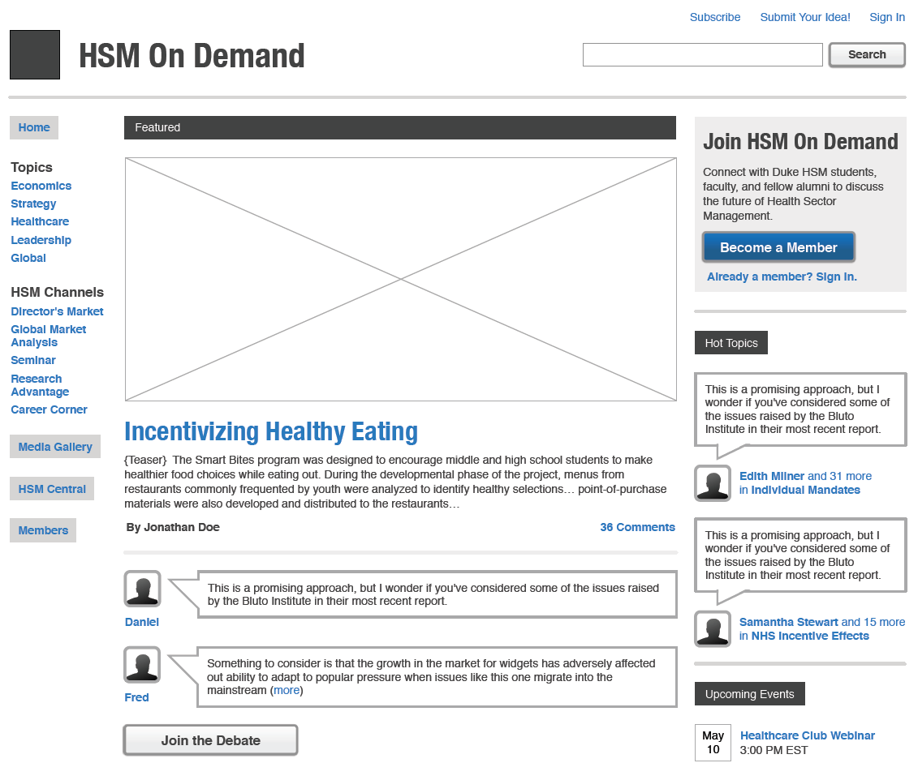

Slide 38
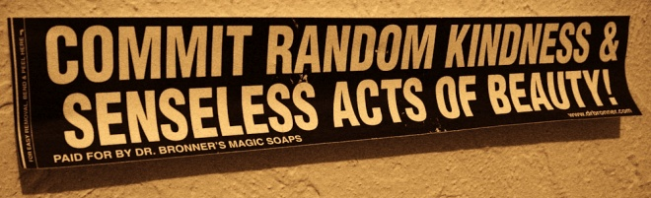
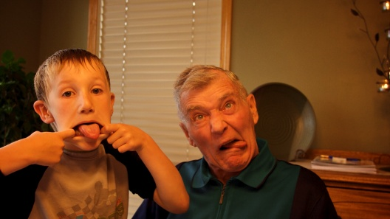
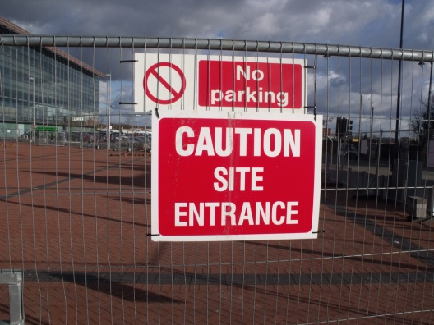
It’s a User Thing–You Wouldn’t Understand
Be Good
Design for real people
Get outside the building

Slide 39
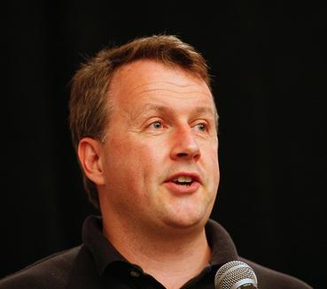
Be Good

Slide 40
Design for real people
Abstractions

Slide 41
Who are our users, really?
Apply it…
Describe one of your customers, in as much detail as possible. Give him or her a name and sketch a picture.

Slide 42
Who are our users, really? (Part 2)
Apply it…
Describe in 30 seconds the need, motivation or pain point you are addressing for the person you just described.

Slide 43
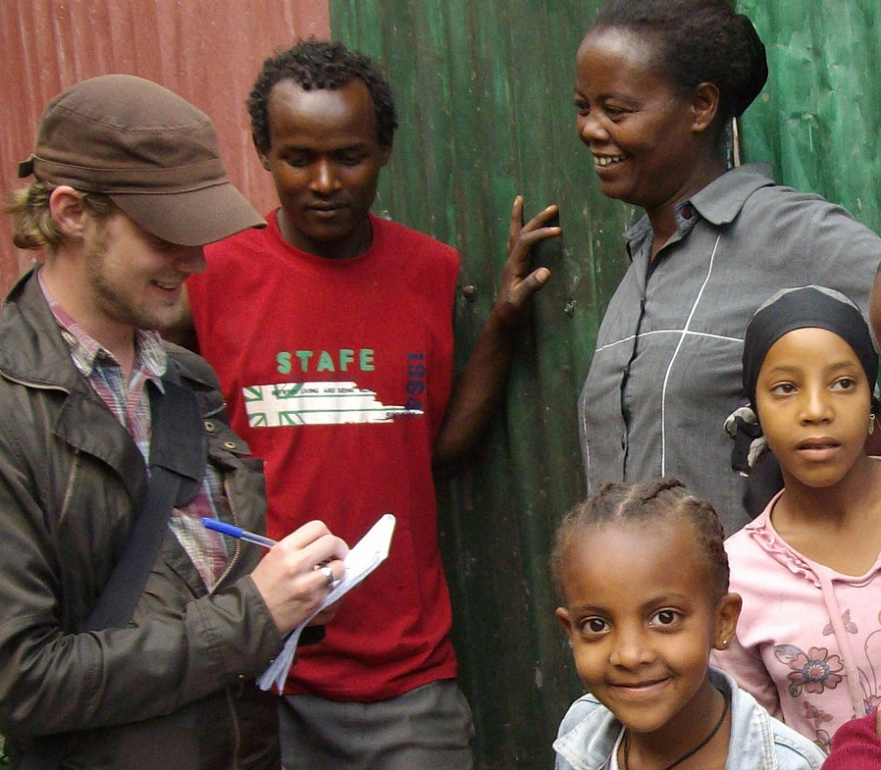
Get outside the building: approaches
Embrace qualitative insights
Interviews
Observation
Participant observation
Be 100% interested in the person and everything about them: you are there to ask questions and listen reflectively, not to talk about yourself

Slide 44
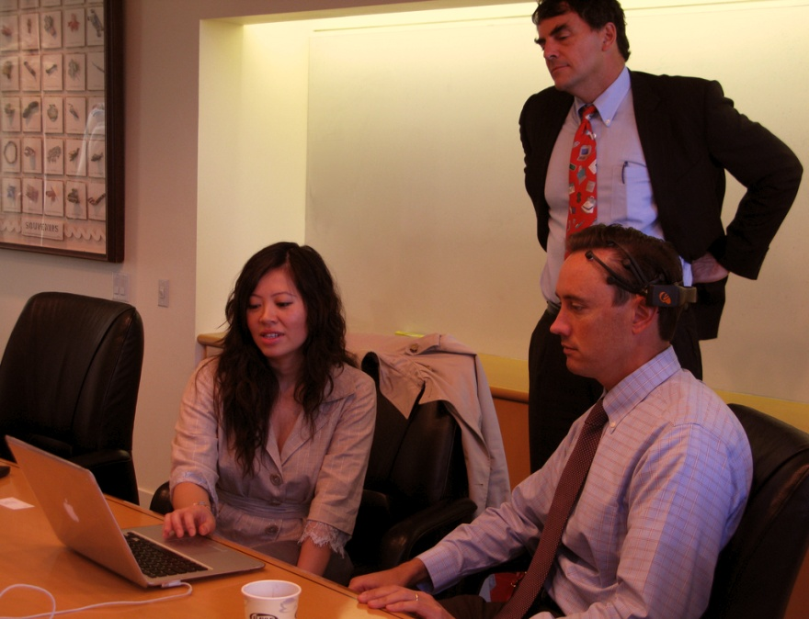
Get outside the building: questions
So, what should I be learning from the customer development interview?
—Cindy Alvarez
http://www.cindyalvarez.com/communication/customer-development-interviews-how-to-what-you-should-be-learning

Slide 45
Face your fears
Apply it…
What’s one small thing you can do THIS WEEK to get “outside the building” and listen to your customers?

Slide 46
Design
Strategy is about FOCUS
Research is about EMPATHY
Design is about CLARITY

Slide 47
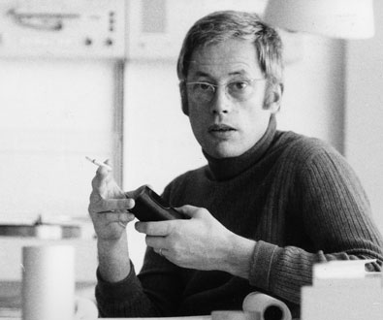
Good design is unobtrusive
“In my experience users react positively when things are clear and understandable.”

Slide 48

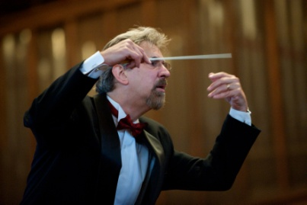
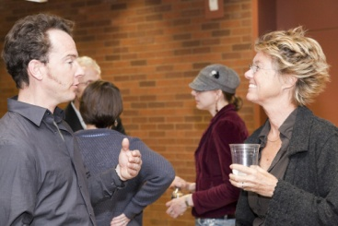
The Design of Everyday Software
Features aren’t enough
Fluid interaction
The dialogue of design
file:///C:/Users/Abe/Documents/My%20Dropbox/clients/projects/UX%20workshop/presentations/Feature%20Checklist.jpg

Slide 49
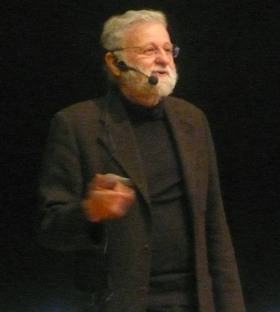
Features aren’t enough

Slide 50

Fluid interactions

Slide 51
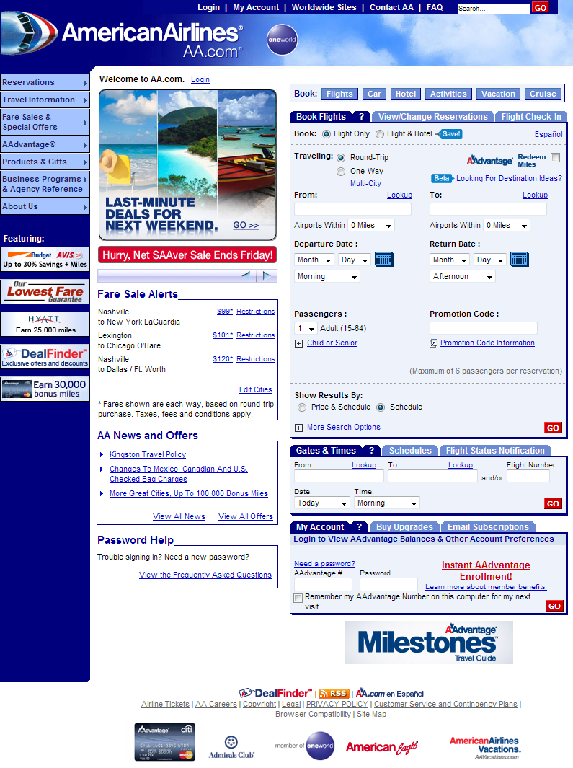

Slide 52
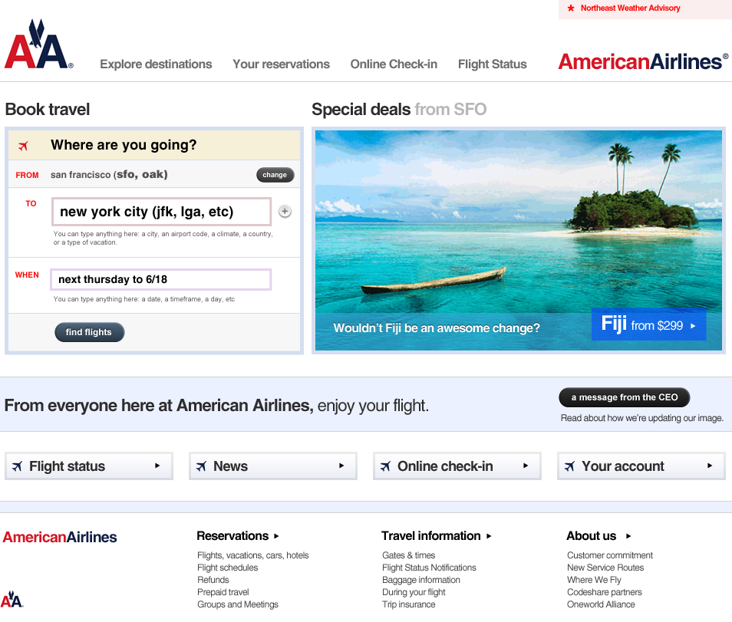

Slide 53
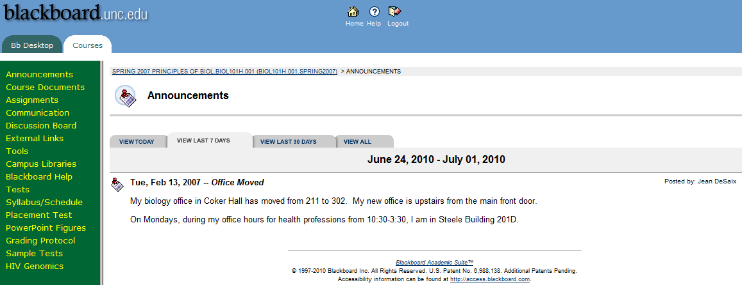

Slide 54
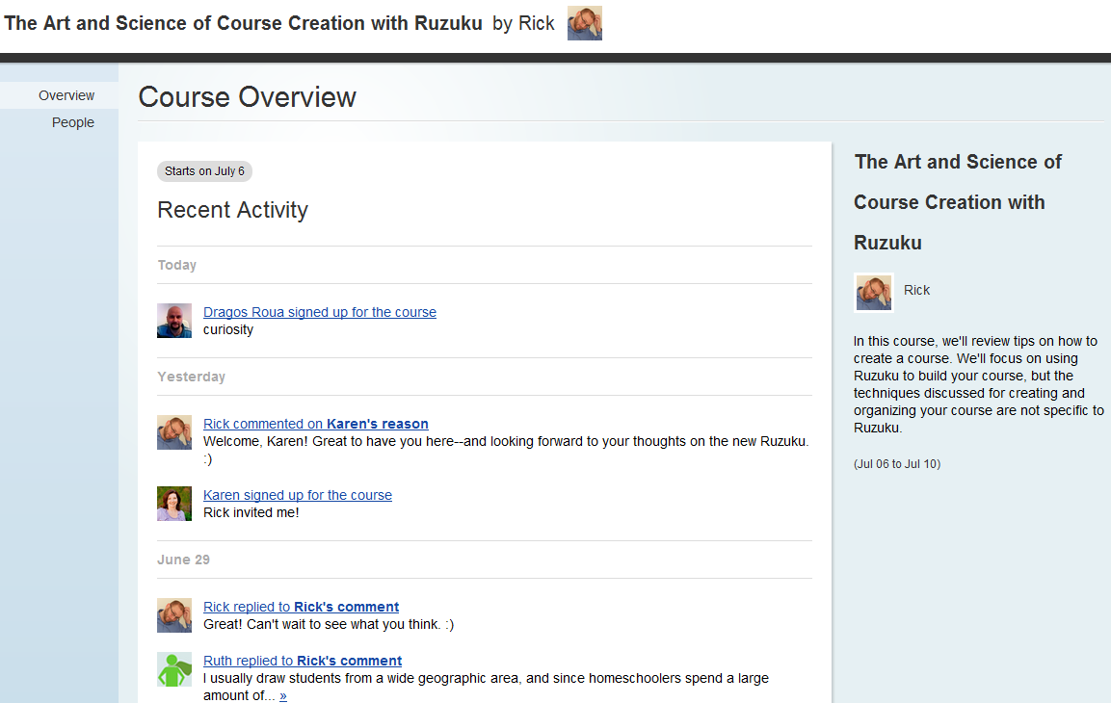

Slide 55
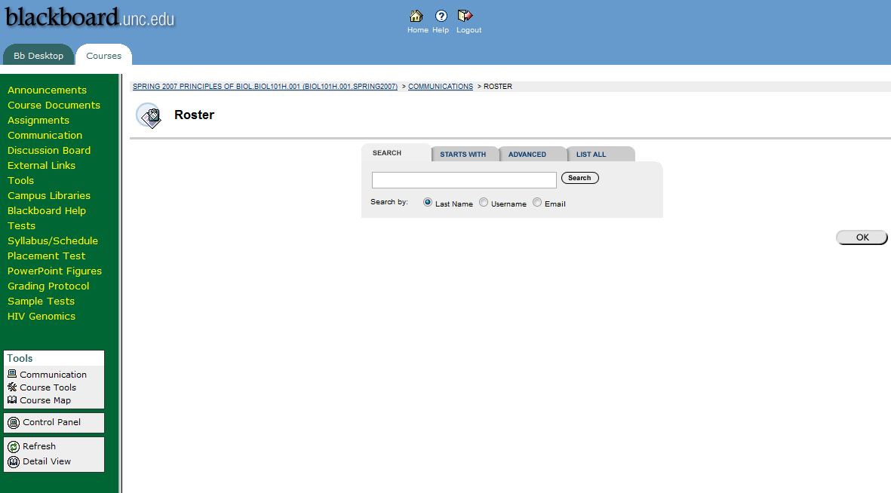

Slide 56
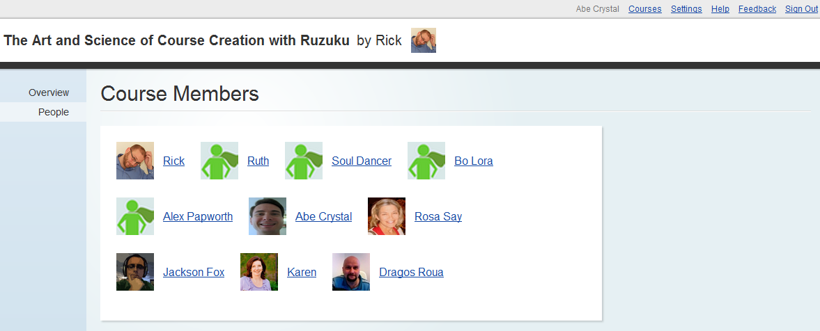

Slide 57
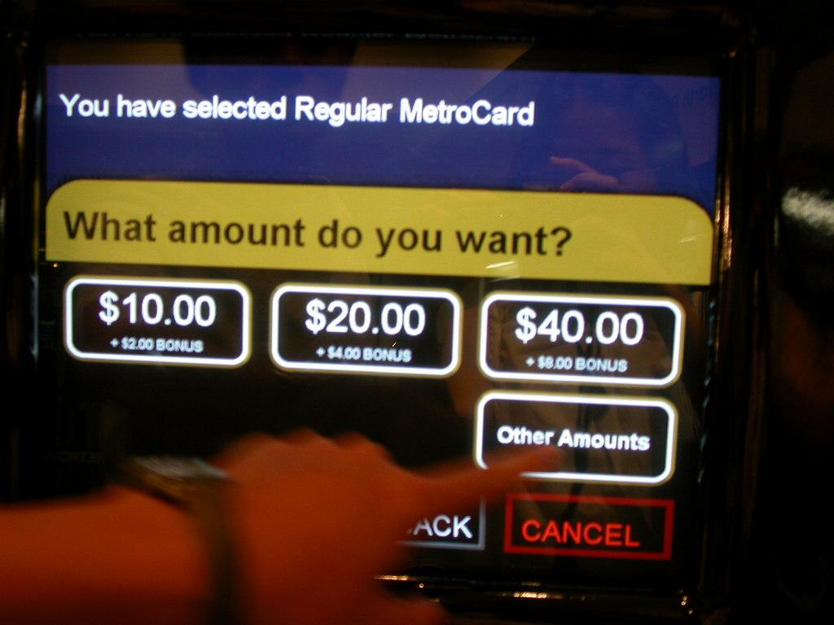

Slide 58
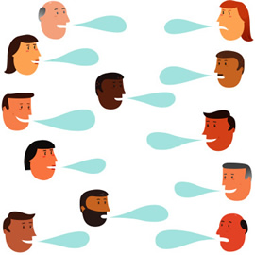
Design is a conversation
Designer and business
Designer and developer
Designer and users

Slide 59
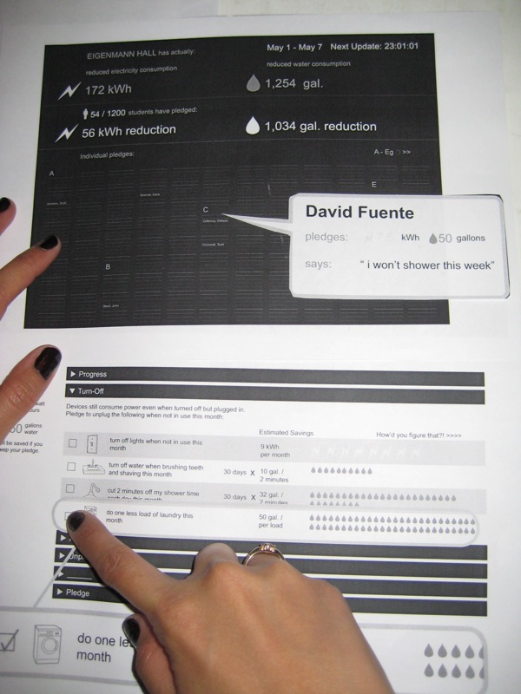
Get it RITE
Rapid Iterative Testing and Evaluation

Slide 60
Design before code
Apply it…
Choose a feature that you're planning to build in the near future. How can you prototype it and get user feedback on it before writing a line of code?

Slide 61
Who do you want to be?

Slide 62
Call to action
UX doesn't have to be a job title.
Start looking for good (and bad) design in your everyday life.
The experience is the product.
Designing great experiences is central to creating value. Make this a focus of your work, today!

Slide 63


